Slide 1
Employee Data Analysis using Excel
STUDENT NAME: jansi priya K
REGISTER NO. :312216946
DEPARTMENT. :Commerce (B.com general)
COLLEGE : Shri Krishnaswamy college for women

Slide 2
PROJECT TITLE
Salary and computation analysis through Excel data modelling.

Slide 3


AGENDA
Problem Statement
Project Overview
End Users
Our Solution and Proposition
Dataset Description
Modelling Approach
Results and Discussion
Conclusion
3/21/2024 Annual Review

Slide 4

PROBLEM STATEMENT
Create an Excel model to analyze and visualize employee salary and compensation data, aiming to identify trends, disparities, and areas for improvement.
Data Integration: Collect and consolidate salary and compensation data.
Data Preparation: Clean and standardize data.
Analysis: Salary distribution by role, department, and experience. Breakdown of total compensation. Pay equity analysis by demographics. Trends and benchmarking against industry standards.

Slide 5

PROJECT OVERVIEW
Deliverables
Excel Model: Data, analysis, and Summary of findings and insights.
Visualizations: Graphs and charts.
Recommendations: Strategic suggestions based on analysis.
Timeline: 5 weeks (Collection, Cleaning, Analysis, Reporting, Review).
Assumptions: Data is accessible and accurate; Excel will be used for analysis.
Success Criteria: Effective identification of patterns and actionable insights.

Slide 6

WHO ARE THE END USERS?
Human resources Management
Finance teams
Senior management
Compensation analysis
Payroll administrator’s

Slide 7

OUR SOLUTION AND ITS VALUE PROPOSITION
Solution: An Excel model for analyzing salary and compensation data, featuring data integration, cleaning, advanced analysis, visualization, and reporting.
Value Propositions:
Informed Decisions: Data-driven insights for better compensation choices.
Pay Equity: Identifies and addresses pay disparities.
Optimization: Aligns compensation costs with financial goals.
Strategic Planning: Enhances HR strategies and policies.
Benchmarking: Compares internal pay with industry standards.
Efficient Reporting: Streamlines report generation and visualization.

Slide 8
Dataset Description
**Collect Data**: Gather information on salaries, bonuses, and other compensation details
2. . **Clean Data**: Remove duplicates and handle missing values.
3. **Organize Data**: Structure data in columns (e.g., Employee ID, Base Salary).
4. **Analyze**: Use pivot tables and charts to explore patterns. Compute basic statistics and trends.
5. **Advanced Analysis**: Apply regression for deeper insights and forecasting.
6. **Report**: Summarize findings with visual aids and dashboards in Excel.

Slide 9

THE "WOW" IN OUR SOLUTION
Data Input: Collect and clean salary data.
Organization: Use tables and data validation.
Formulas: Apply functions like SUM, IF, VLOOKUP.
Pivot Tables: Summarize and analyze data.
Analysis: Use conditional formatting and what-if analysis tools.
Models/Dashboards: Forecast trends and visualize data.
Automation: Implement macros or VBA for efficiency.
Reporting: Create interactive reports and dashboards.
3/21/2024 Annual Review
9

Slide 10
MODELLING
Define Goals: Identify analysis objectives.
Prepare Data: Structure data with necessary fields.
Create Model: Use Excel Tables and relationships.
Design Calculations: Apply relevant formulas.
Pivot Tables: Summarize and analyze data.
10

Slide 11
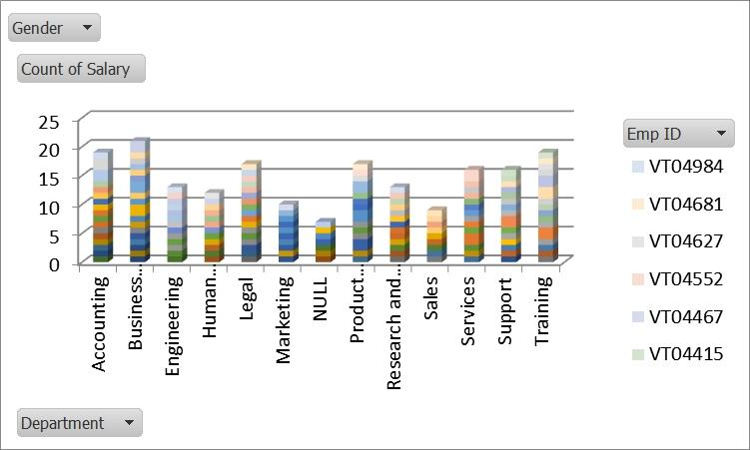
RESULTS
11

Slide 12
conclusion
Excel data modeling for salary and compensation analysis enables efficient management and insightful evaluation of salary data. By leveraging structured data, advanced formulas, and visualization tools, you can:
Overall, Excel provides a robust platform for detailed salary analysis, helping organizations optimize their compensation strategies effectively.

